Slide 1


Vegetation Dynamics of Round Bald
J. Ted Hillert

Slide 2
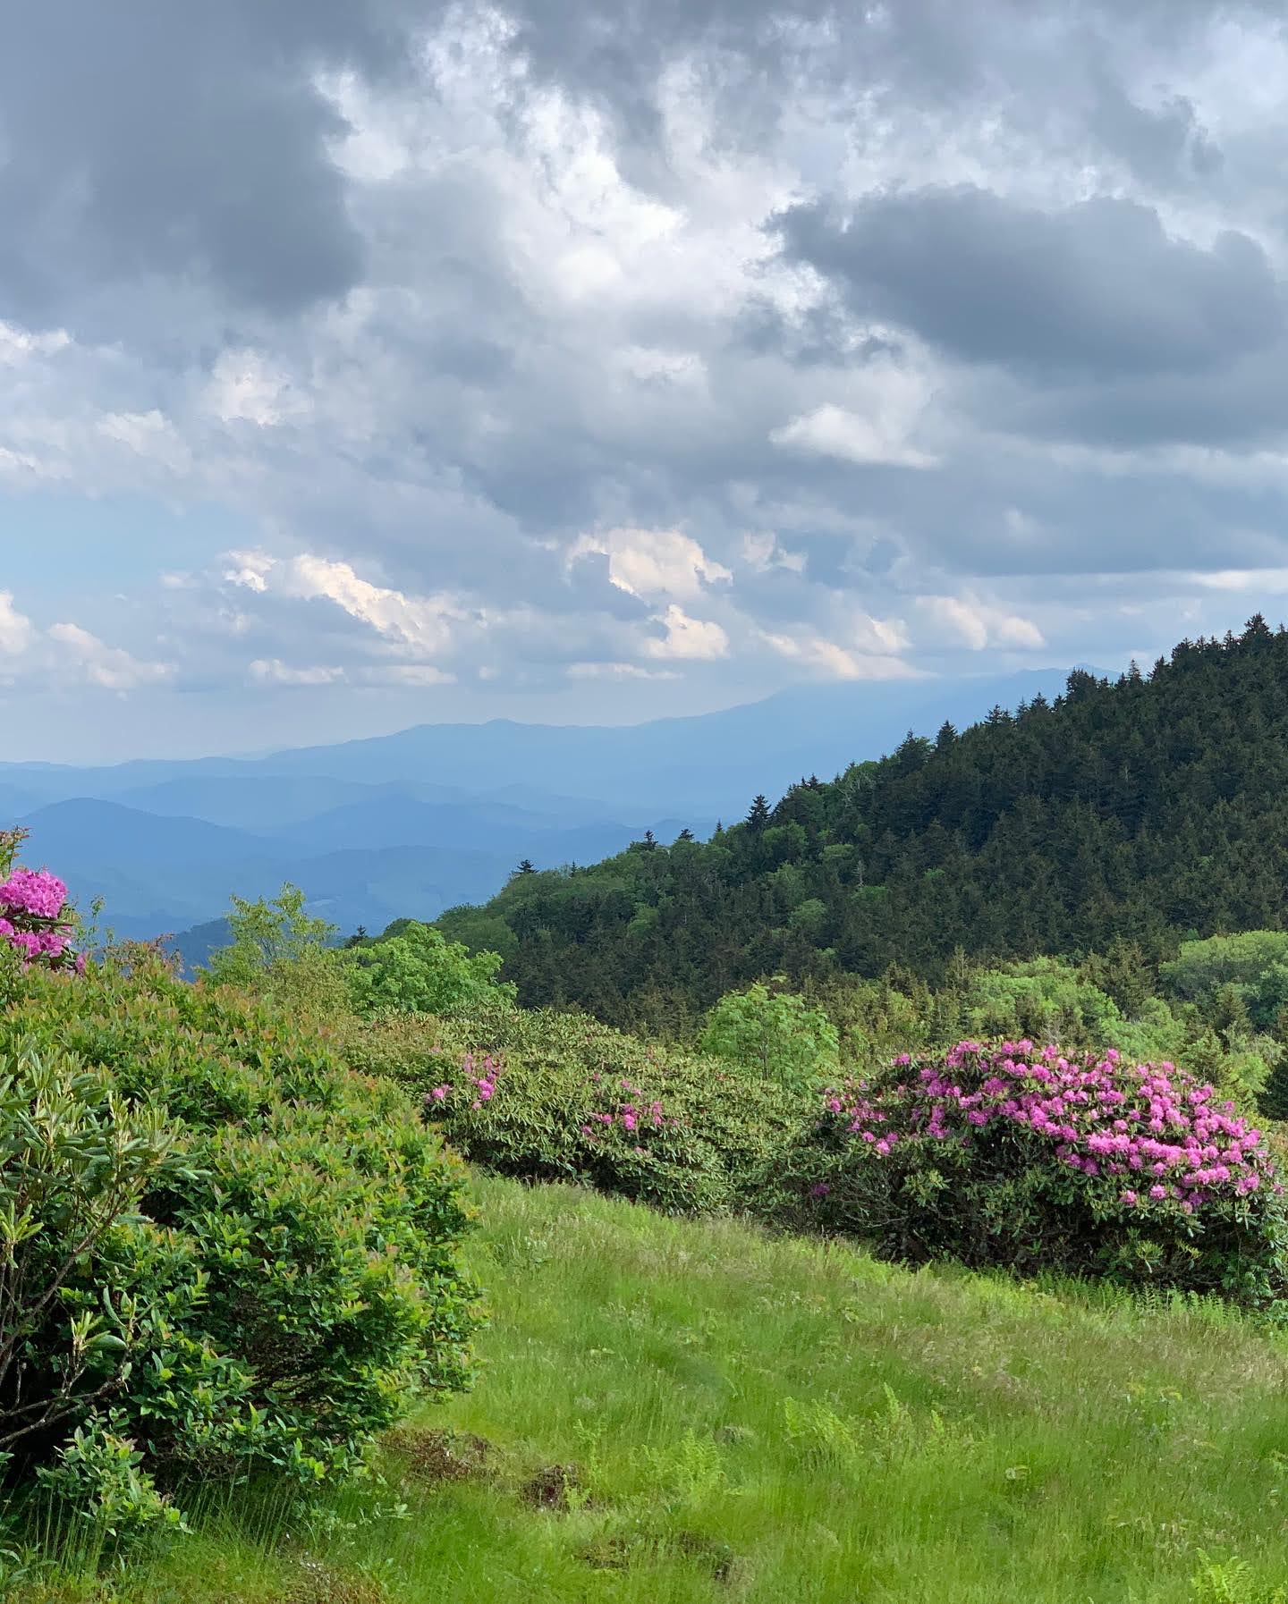

What is a Bald?
Upper montane treeless meadows
Host high floral and faunal diversity
Host to many rare endemic species
Lilium grayi Gray’s Lily
Geum radiatum Spreading Avens
Carex roanensis Roan Sedge
Either natural ecosystems or anthropogenic in origin
Panoramic views of surrounding mountain ranges

Slide 3
What is a Bald?
High elevation rock outcrops
Grass balds
Dominated by grass and sedge species with various forbs
Heath balds
Dominated by ericaceous flora with few grasses, sedges, or forbs

Slide 4
History of Balds
Still in debate about the origins of balds; manmade or natural ecosystems.
Either they were cleared by native people or by early colonists
Anthropogenic perspective;
They were occasionally cleared for timber by early colonists
There are some instances of prescribed fire to expand bald boundaries
Natural ecosystem perspective;
Herbivore grazing drove back woody vegetation
Climate extremes around the Pleistocene further opened these areas
A combination of the two led to persistence of light dependent species that favor frequent disturbance
Used as summertime rangeland for cattle by colonists
Or they are climate-herbivore driven ecosystems

Slide 5
Round Bald
Located along the borders of NC and TN on the Appalachian trail of Roan Mountain
First bald on Carver’s gap
followed by Jane bald and Grassy Ridge bald
20 miles north of Bakersville, NC
13 miles south of Roan Mountain, TN

Slide 6
Woody Encroachment
Round bald is experiencing woody encroachment from the surrounding forests
Main contributors; Rubus canadensis and Rubus allegheniensis (Blackberry spp.)
Grows predominantly from rootstocks to form a colony and outcompetes grasses, sedges, and slow growing forbs
Repeated disturbance is needed to maintain dominance of grasses

Slide 7

Management
Round bald is considered a grass bald and its preservation as a grass bald is of high importance
It is managed through mowing of woody vegetation in the summer months prior to the fruiting of blackberry
In 2020 a survey by Stokes and Horton was conducted following 30-years of mowing management
It is continually monitored as part of the Appalachian Trail system by the Southern Appalachian Highlands Conservancy

Slide 8
Fire on Round Bald
In February 2022, a low-intensity ground fire occurred on Round Bald
Approximately 9.7 hectares were burned
The fire occurred across the first four transects measured by Stokes and Horton in 2020
This provided an avenue to examine vegetation dynamics before and after a disturbance

Slide 9
Study Objectives
1. Quantify vegetation composition and the soil seed bank over the first and second growing seasons following the low intensity ground fire on Round Bald
2. Inform managing agencies about the benefits/drawbacks of naturally occurring fires

Slide 10
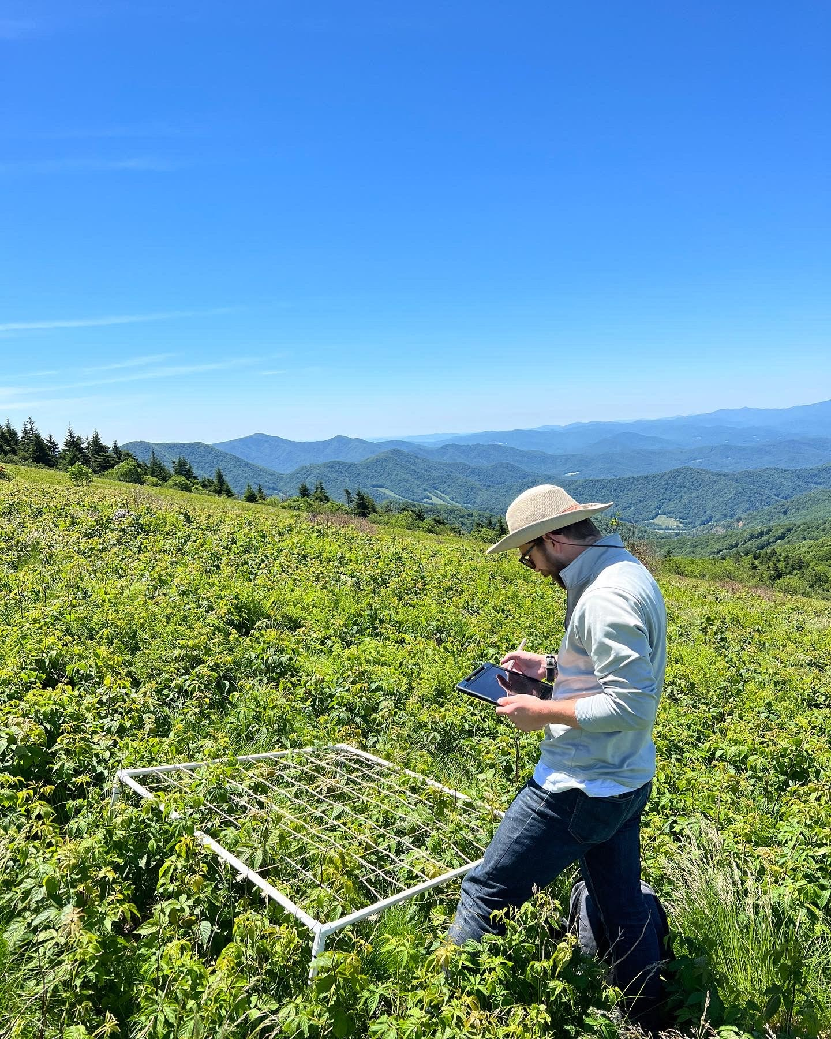
Study Site 36° 06’N and 82° 60’W
Located in the Roan Mountain Massif of the Unaka Mountain range across Pisgah and Cherokee National Forests
The Appalachian trail bisects the study site into North and South of the trail

Slide 11
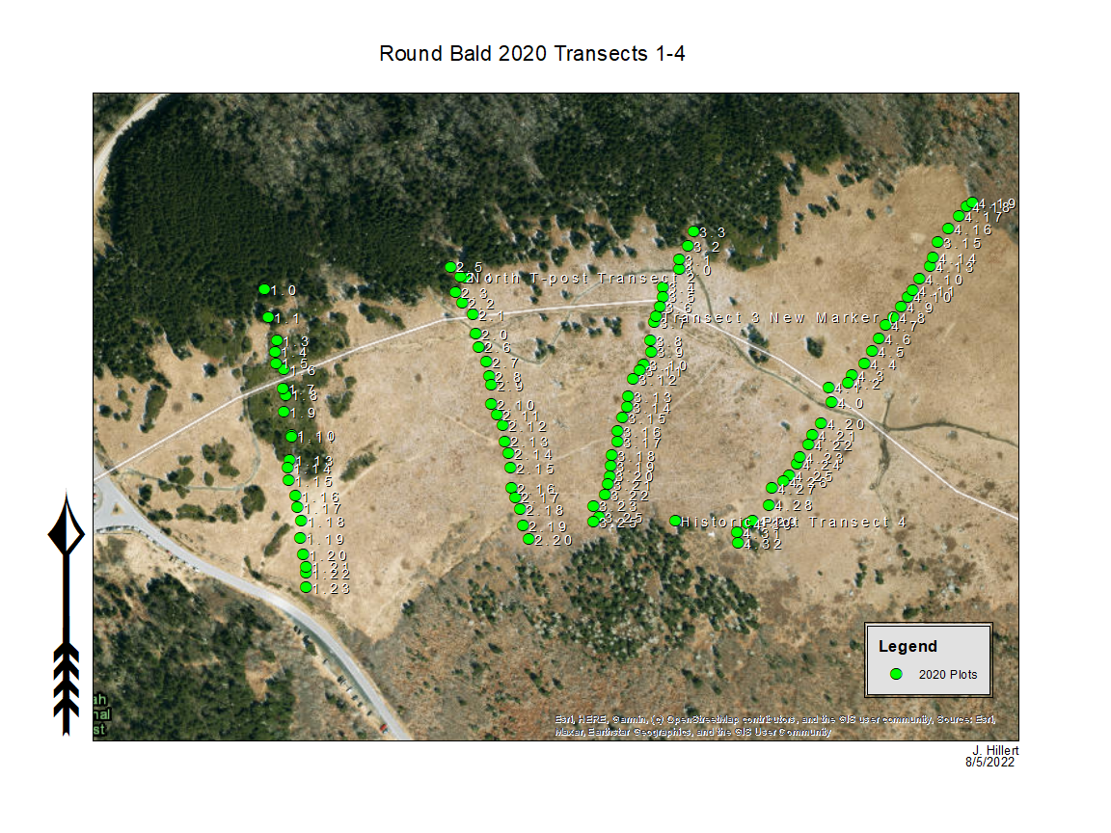

Slide 12
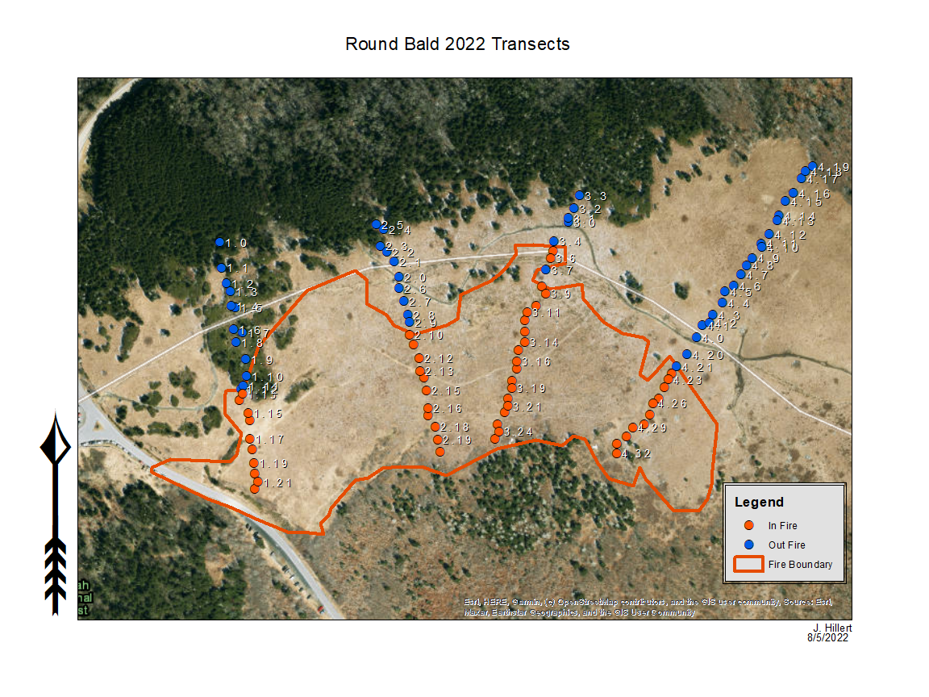

Slide 13
Field Methods June 2022
Divided into four transects that run north to south with the Appalachian Trail as the central line
Each transect is 150 meters apart following Stokes and Horton (2022)
Plots were sampled every 8-12 meters along each transect and were within 2 meters of the GPS points laid out by Stokes and Horton in 2020
Each plot was divided into 100 equal sized squares by a 1x1 square meter quadrat
Functional vegetation groups were identified and recorded
Grass, Sedge, Rubus, Vaccinium, Rhododendron, forb, etc.
In 2020, 226 plots were recorded along 12 transects
In 2022, 52 burned plots and 47 unburned plots were measured along the first four transects

Slide 14
Soil Seed Bank 2022
Soil seed bank samples were acquired to quantify the “potential community” layer
In July 2022, a total of 24 soil samples were collected from each of four categories
<25% Rubus-unburned, <25% Rubus-burned, >50% Rubus-unburned, >50% Rubus-burned
Notes:
2022 potential sampling sites were pooled into the following categories; <25% Rubus-unburned, <25% Rubus-burned, >50% Rubus-unburned, and >50% Rubus-burned. Samples were taken from six sites under each category.
2023 potential sampling sites were pooled into the same categories as the previous year. This time three samples at each site, with six total sites visited per category.

Slide 15


Slide 16
Greenhouse
Seed bank samples were sown in 28x22 cm seedling trays filled with potting soil to 5 cm depth
An additional 6 trays acted as greenhouse controls
Trays were randomly arranged in two rows of fifteen trays, watered every 2-3 days, and rotated once monthly
A Govee probe was used to continuously monitor temperature and percent relative humidity
Species that grew were identified and recorded
In December of 2022 trays were set outside under a tarp to simulate winter weather

Slide 17
Soil Seed Bank 2023
In January 2023, a second seed bank sample was collected and set in the fridge until Spring 2023
Seed bank samples will undergo seedling emergence and seed extraction trials to quantify the seed bank
Notes:
2022 potential sampling sites were pooled into the following categories; <25% Rubus-unburned, <25% Rubus-burned, >50% Rubus-unburned, and >50% Rubus-burned. Samples were taken from six sites under each category.
2023 potential sampling sites were pooled into the same categories as the previous year. This time three samples at each site, with six total sites visited per category.

Slide 18
Preliminary Analysis
Greater percentage of Rubus and Grass was within the fire boundary versus unburned.
Fire showed a significant effect on Rubus (p=0.0478)
Fire showed an insignificant effect on Grass (p=0.9729)
More analysis is underway to determine effect size

Slide 19
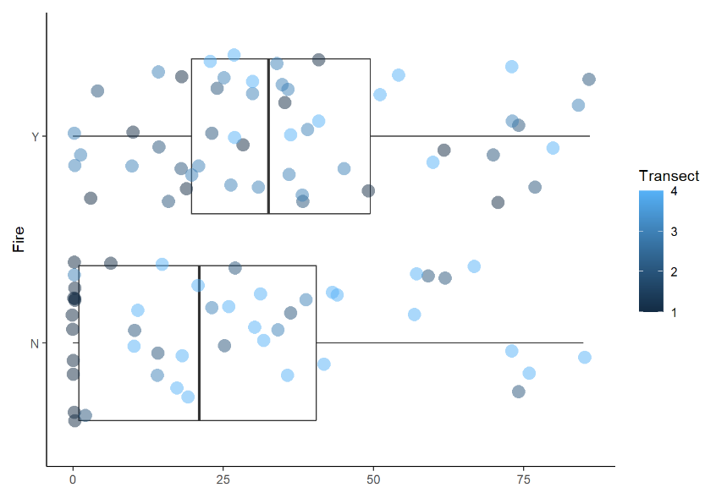
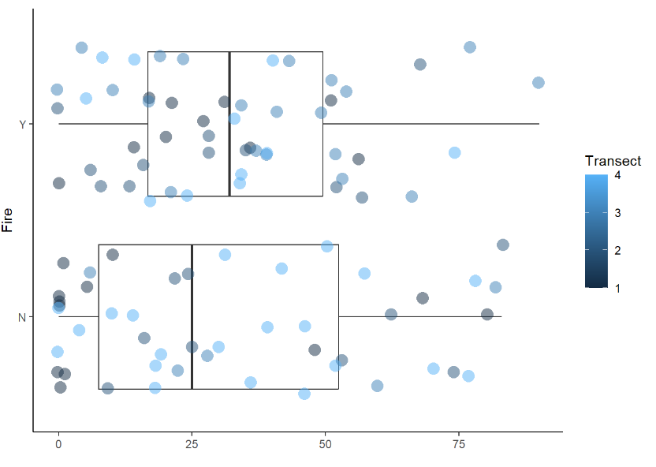
Figures
Figure 1. Distribution of plots containing Rubus
in burned and unburned
Figure 2. Distribution of plots containing Grass
in burned and unburned

Slide 20
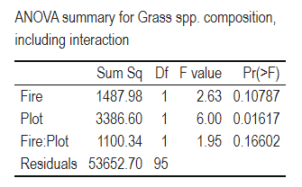
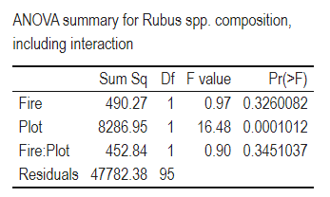
Tables

Slide 21
Expected Outcomes
I expect grass species to respond favorably to the fire and rubus to be slightly decreased in area following the fire
Future PCA analysis will determine how different the 2023 vegetation community is to the 2022 and 2020 communities

Slide 22
Acknowledgements
Graduate Thesis Committee for consistent guidance and direction
US Forest service, National Park Service, and the Southern Appalachian Highlands Conservancy for information
The graduate students for acting as a sounding board and offering advice

Slide 23
References
Abella, S. R., L. P. Chiquoine, and C. H. Vanier. 2013. Characterizing soil seed banks and relationships to plant communities. Plant Ecology 214:703–715.
Chiquoine, L. P., and S. R. Abella. 2018. Soil seed bank assay methods influence interpretation of non-native plant management. Applied Vegetation Science 21:626–635.
Davies, R. 1998. Regeneration of blackberry-infested native vegetation. Plant Protection Quarterly 13:189–195.
Gersmehl, P. 1970. A geographic approach to a vegetation problem: The case of the southern appalachian grass balds. Ph.D. Dissertation, University of Georgia, Athens, GA. 463 pp.
Hamel, P., and P. Somers. 1990. Vegetation analysis report: Roan mountain grassy balds. Challenge Cost Share Project.:25.
Lindsay, M. M., and S. P. Bratton. 1979a. The vegetation of grassy balds and other high elevation disturbed areas in the great smoky mountains national park. Bulletin of the Torrey Botanical Club 106:264–275.
Lindsay, M. M., and S. P. Bratton. 1979b. Grassy balds of the great smoky mountains: Their history and flora in relation to potential management. Environmental Management 3:417–430.

Slide 24
References
Lindsay, M. M., and S. P. Bratton. 1980. The rate of woody plant invasion on two grassy balds. Castanea 45:75–87.
McCune, B., and M. J. Medfford. 2016. PC-ORD. Multivartiate analysis of ecological data. Version 7. MjM Software Design, Gleneden Beach, Oregon, USA.
Moravek, S., J. Luly, J. Grindrod, and R. Fairfax. 2013. The origin of grassy balds in the bunya mountains, southeastern queensland, australia. The Holocene 23:305–315.
Murdock, N. A. 1986. Evaluation of management techniques on a southern appalachian bald. Unpublished M.S. Thesis. Western Carolina University. 62 pp.
Price, J. N., B. R. Wright, C. L. Gross, and W. R. D. B. Whalley. 2010. Comparison of seedling emergence and seed extraction techniques for estimating the composition of soil seed banks. Methods in Ecology and Evolution 1:151–157.
Stokes, C., and J. L. Horton. 2022. Effects of grassy bald management on plant community composition within the roan mountain massif. Castanea 87:105–120.
Weigl, P. D., and T. W. Knowles. 1995. Megaherbivores and southern appalachian grass balds. Growth and Change 26:365–382.
Weigl, P. D., and T. W. Knowles. 2014. Temperate mountain grasslands: A climate-herbivore hypothesis for origins and persistence. Biological Reviews 89:466–476.

